Slide 1
Review All Slides
Once Completed, send an email to Jeffery.w.hutcherson.civ@army.mil
Stating you have reviewed all the CAH Briefing slides and fully understand the rules of participation.
If you have any questions on the material within, please call:
520-674-0449

Slide 2
CANTONMENT ARCHERY
2024-2025 Hunting Season
Rules of Engagement
!!QDM POLICY DOES NOT APPLY!

Slide 3
BLUF
This is a SPECIAL program; it is not part of the regular hunting program
DO
  !!!!!!!!!HARVEST DOES!!!!!!!!!
  BE CONSIDERATE OF OTHERS
  COMPLY WITH Hunting Reg. 200-1
  VACATE AREA IMMEDIATELY IF NON-HUNTERS OR TRAINING UNITS PRESENT
  ACT IN A PROFESSIONAL AND ETHICAL MANNER
DON’T
  JEAPORDIZE THE PROGRAM
  FIELD DRESS IN CANTONMENT AREAS
  BAIT IN ANY CANTONMENT AREAS

Slide 4
Requirements
Authorized individuals as stated in Ch 3-2 b. (1-12) of Regulation 200-1. NO GUEST HUNTERS
MUST have current Access Pass and Post Permit
MUST review briefing on iSportsman before qualification shoot
MUST send email to Jeffery.W.Hutcherson.civ@army.mil stating you have reviewed and understand the rules of engagement
MUST select a scheduled qualification shoot as announced (if required).
MUST bring and use own safety harness, bow and arrows w/ broadheads (practice mechanicals O.K.) to qualification shoot. NO FIELD POINTS!
MUST qualify with bow by placing 2 of 3 arrows in 8” target at 30 yards from an elevated stand. Archers with traditional equipment can qualify at 20 yards.
MUST qualify with the weapon you will hunt with - bow and/or crossbow
ONLY one attempt to qualify at each qualification session. !!!MAX of TWO ATTEMPTS PER HUNTER!!!

Slide 5
Qualification Proficiency Shoot
Participants who qualified the previous season are not required to attend a qualification shoot. But will need to qualify again the following season.
New participants or participants who did not qualify the previous seasons will need to attend a qualification shoot.
Participants will need to sign up for a shoot time through email. Jeffery.W.Hutcherson.civ@army.mil Once requested, shoot times will be sent to you through your iSportsman email account.

Slide 6
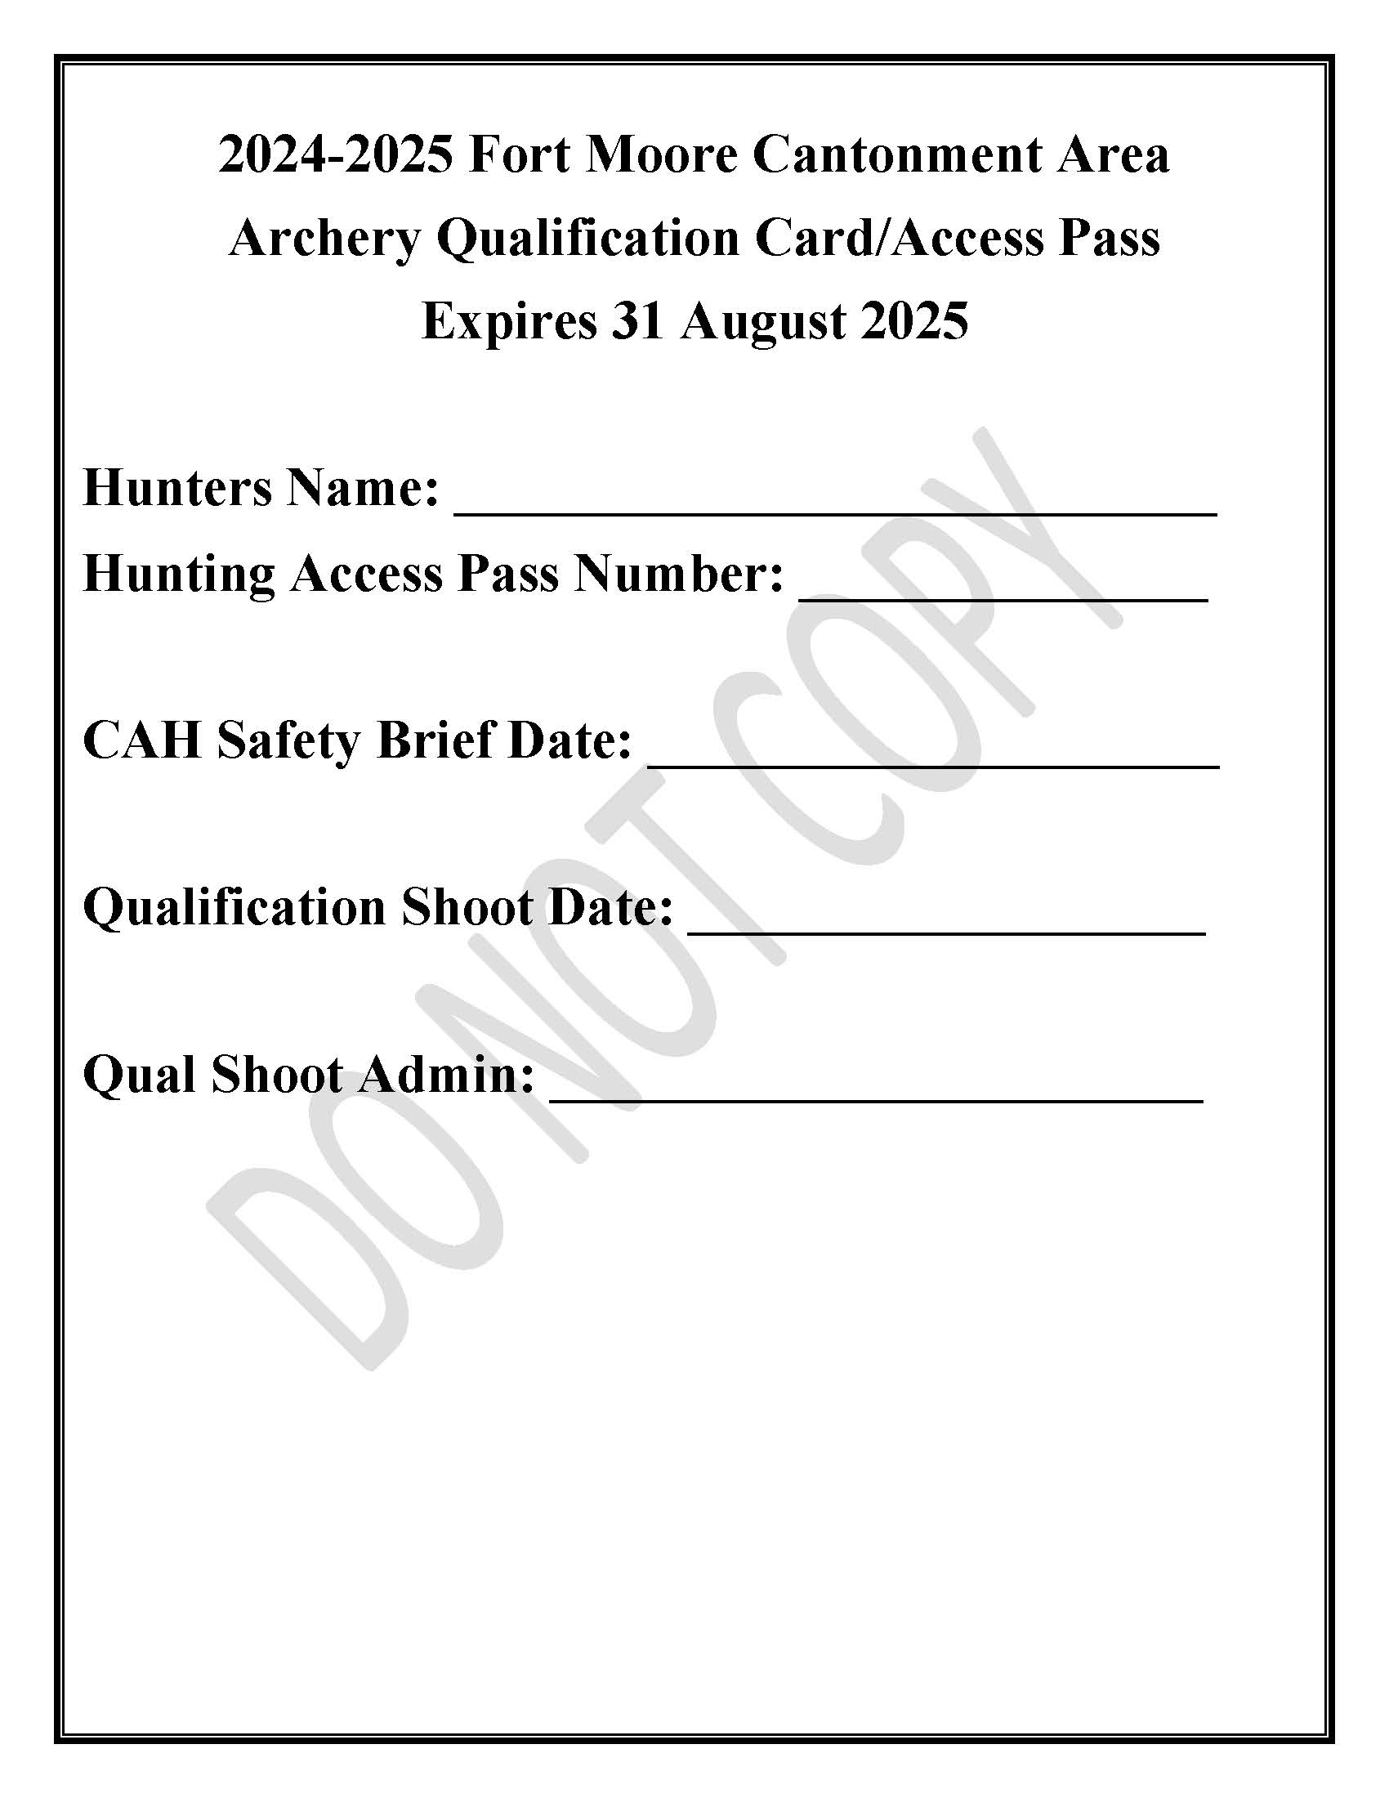
CAAQCAP will be emailed once qualified

Slide 7
SPECIFICS
CHECK IN
  iSPORTSMAN CHECK IN CODE 7771-7774 (See attached Maps)
  REPORT *ALL HARVESTED GAME*
  ONLY one area at a time – You will be removed from the eligible list for violating this rule
TREE STANDS
  NO HUNTING FROM THE GROUND
  AT LEAST 10’ OFF THE GROUND
  NO SCREW IN PEGS, NAILS, ETC.
SCOUTING
  1100-1400 HOURS DURING SEASON
  MUST CHECK IN THROUGH iSPORTSMAN

Slide 8
SPECIFICS (CONTD…)
PARKING
  DO NOT IMPEDE TRAFFIC FLOW
  DISPLAY CAAQCAP AND ACCESS PASS IN FRONT WINDSHIELD
ADDITIONAL INFORMATION
  NO STANDS WITHIN 200’ OF
    HOUSES, ROADS, WALKING TRAILS, SCHOOLS, SCHOOL GROUNDS OR OTHER OCCUPIED INFRASTRUCTURE
  FOCUS ON HARVESTING DOES AND FERAL SWINE
  HUNTING AREAS DIVIDED INTO FOUR AREAS
HARVEST
  DEER – Post QDM DOES NOT apply, State and Post limits DO!
  WILD PIGS no limit
  COYOTES no limit

Slide 9
SPECIFICS (CONTD…)
REMOVING GAME
  DO NOT FIELD DRESS ANIMALS
  DISCRETE REMOVAL
  IF OUT OF DESIGNATED AREAS CONTACT MP’S (545-5222) BEFORE PROCEEDING IN TRACKING WOUNDED GAME
FIREARMS
  NO FIREARMS OF ANY TYPE IN POSESSION, INCLUDING IN VEHICLE
VIOLATIONS
  1 YEAR SUSPENSION
  3 YEAR RESTRICTION FROM CANTONMENT ARCHERY AREAS

Slide 10
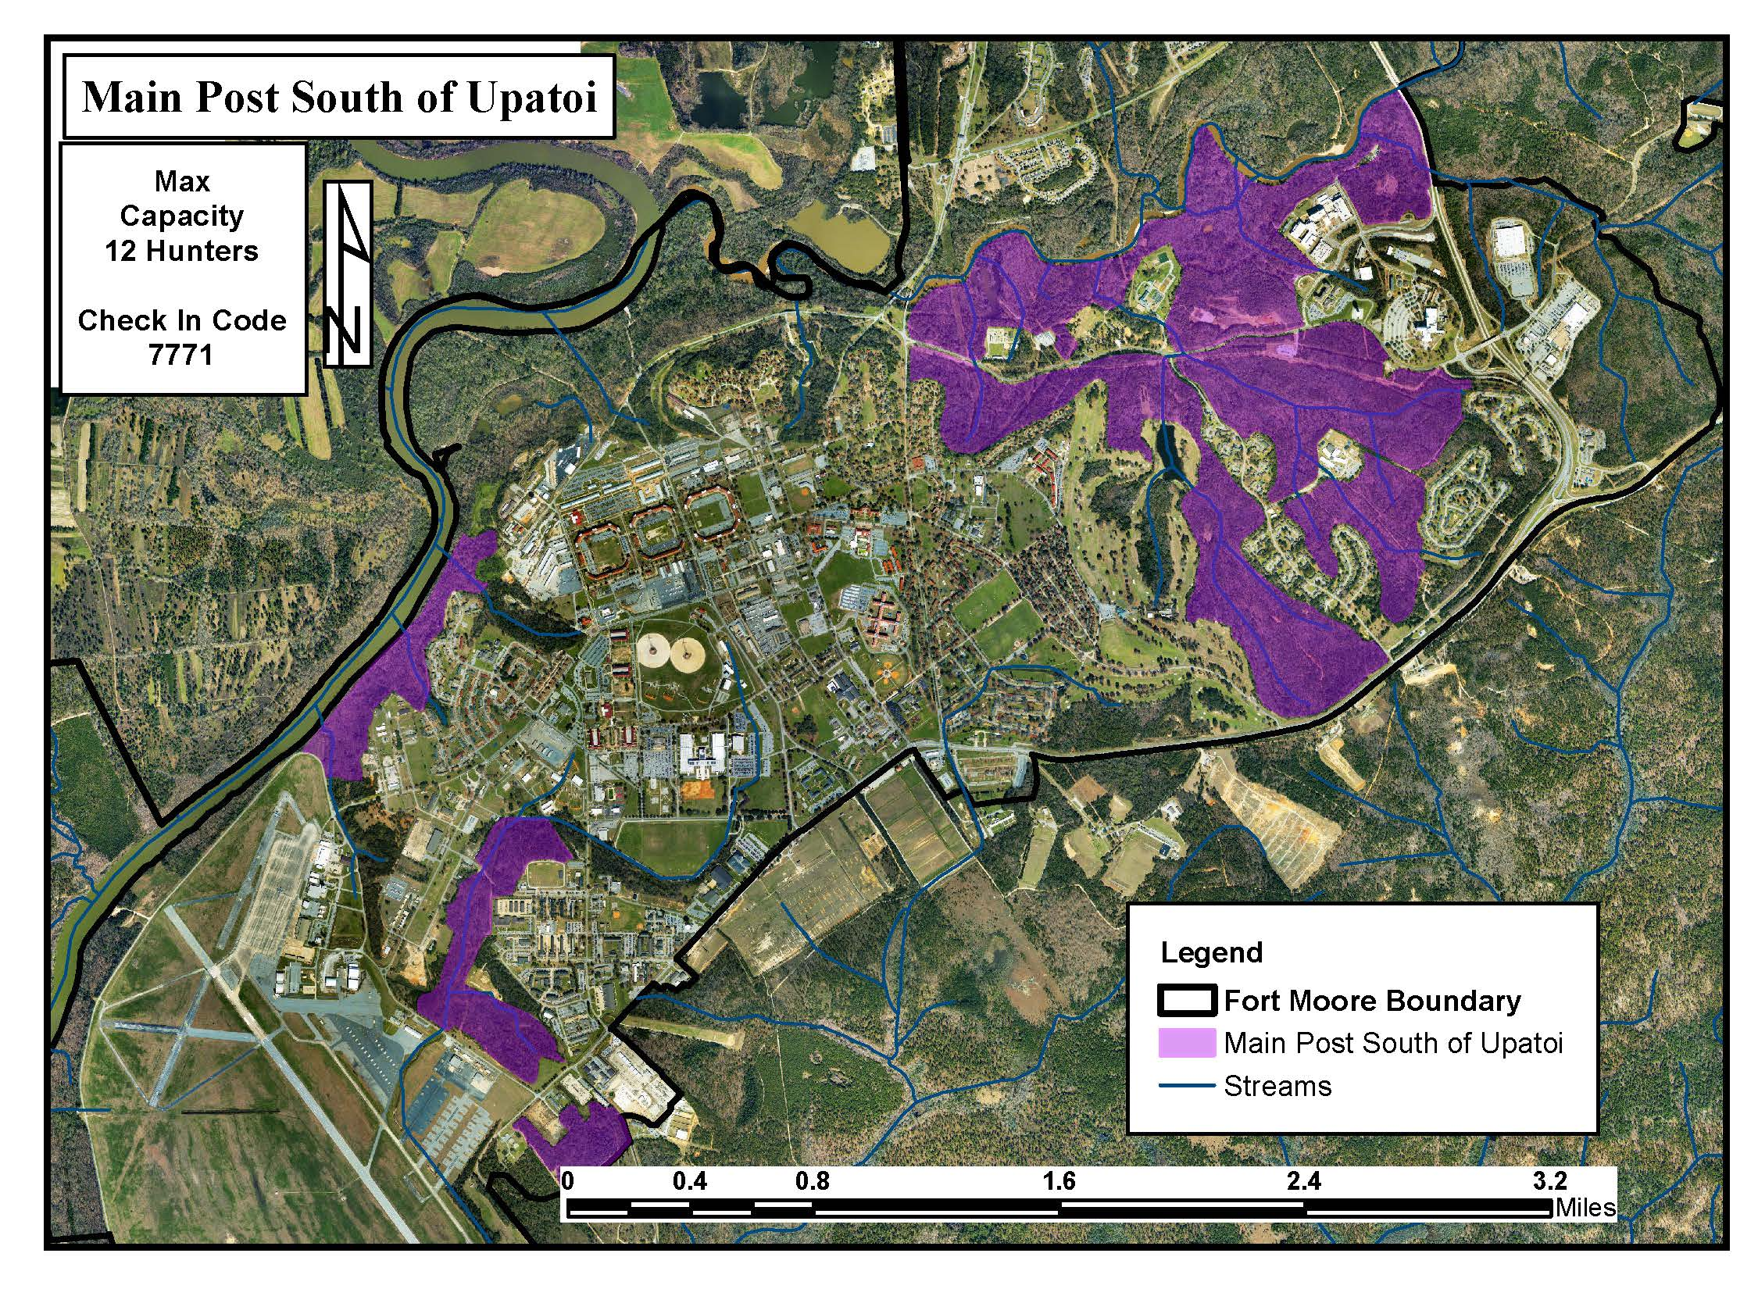
7771
12 Hunters

Slide 11
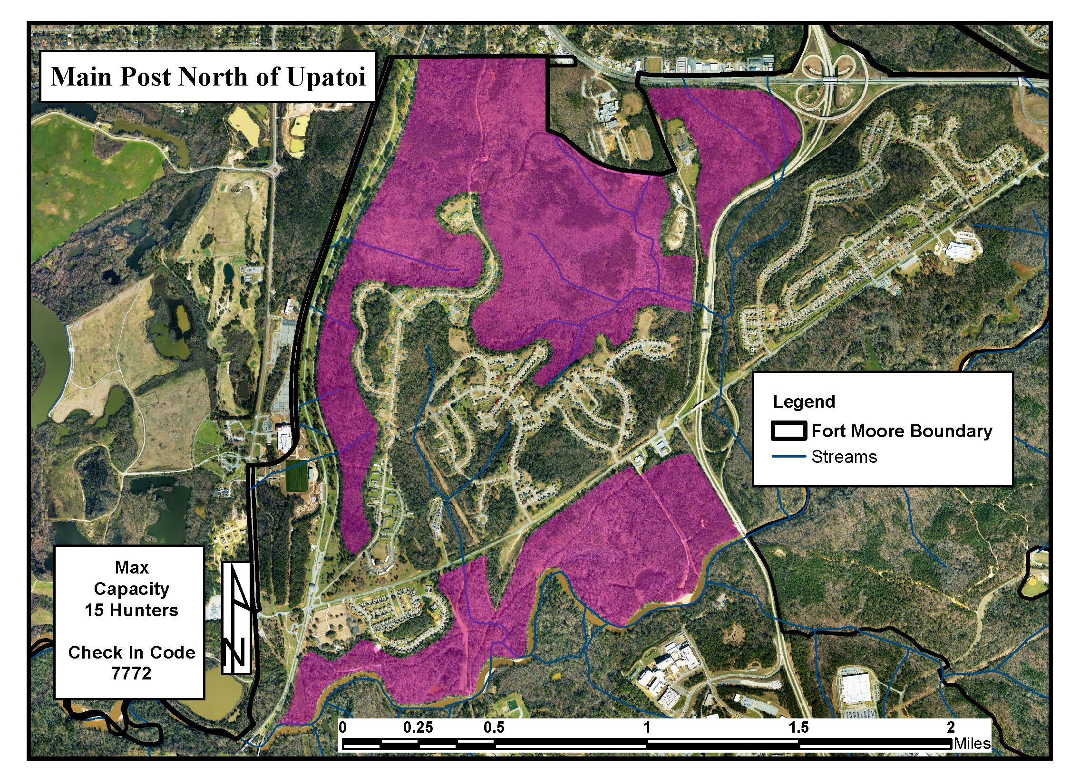
7772
15 Hunters

Slide 12
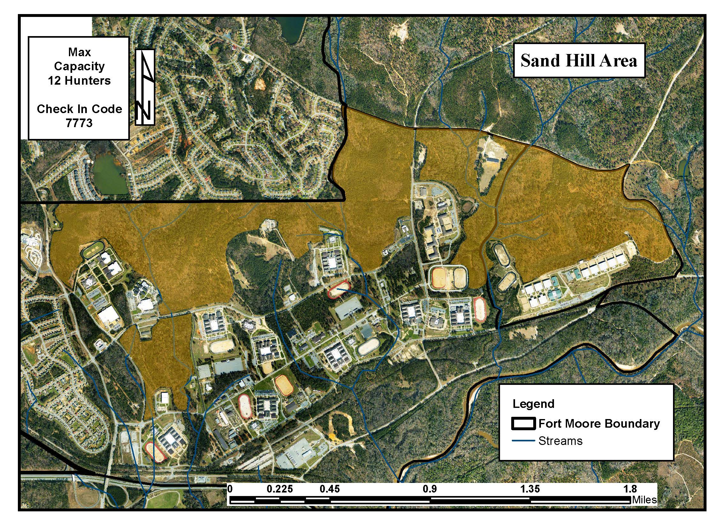
7773
12 Hunters

Slide 13
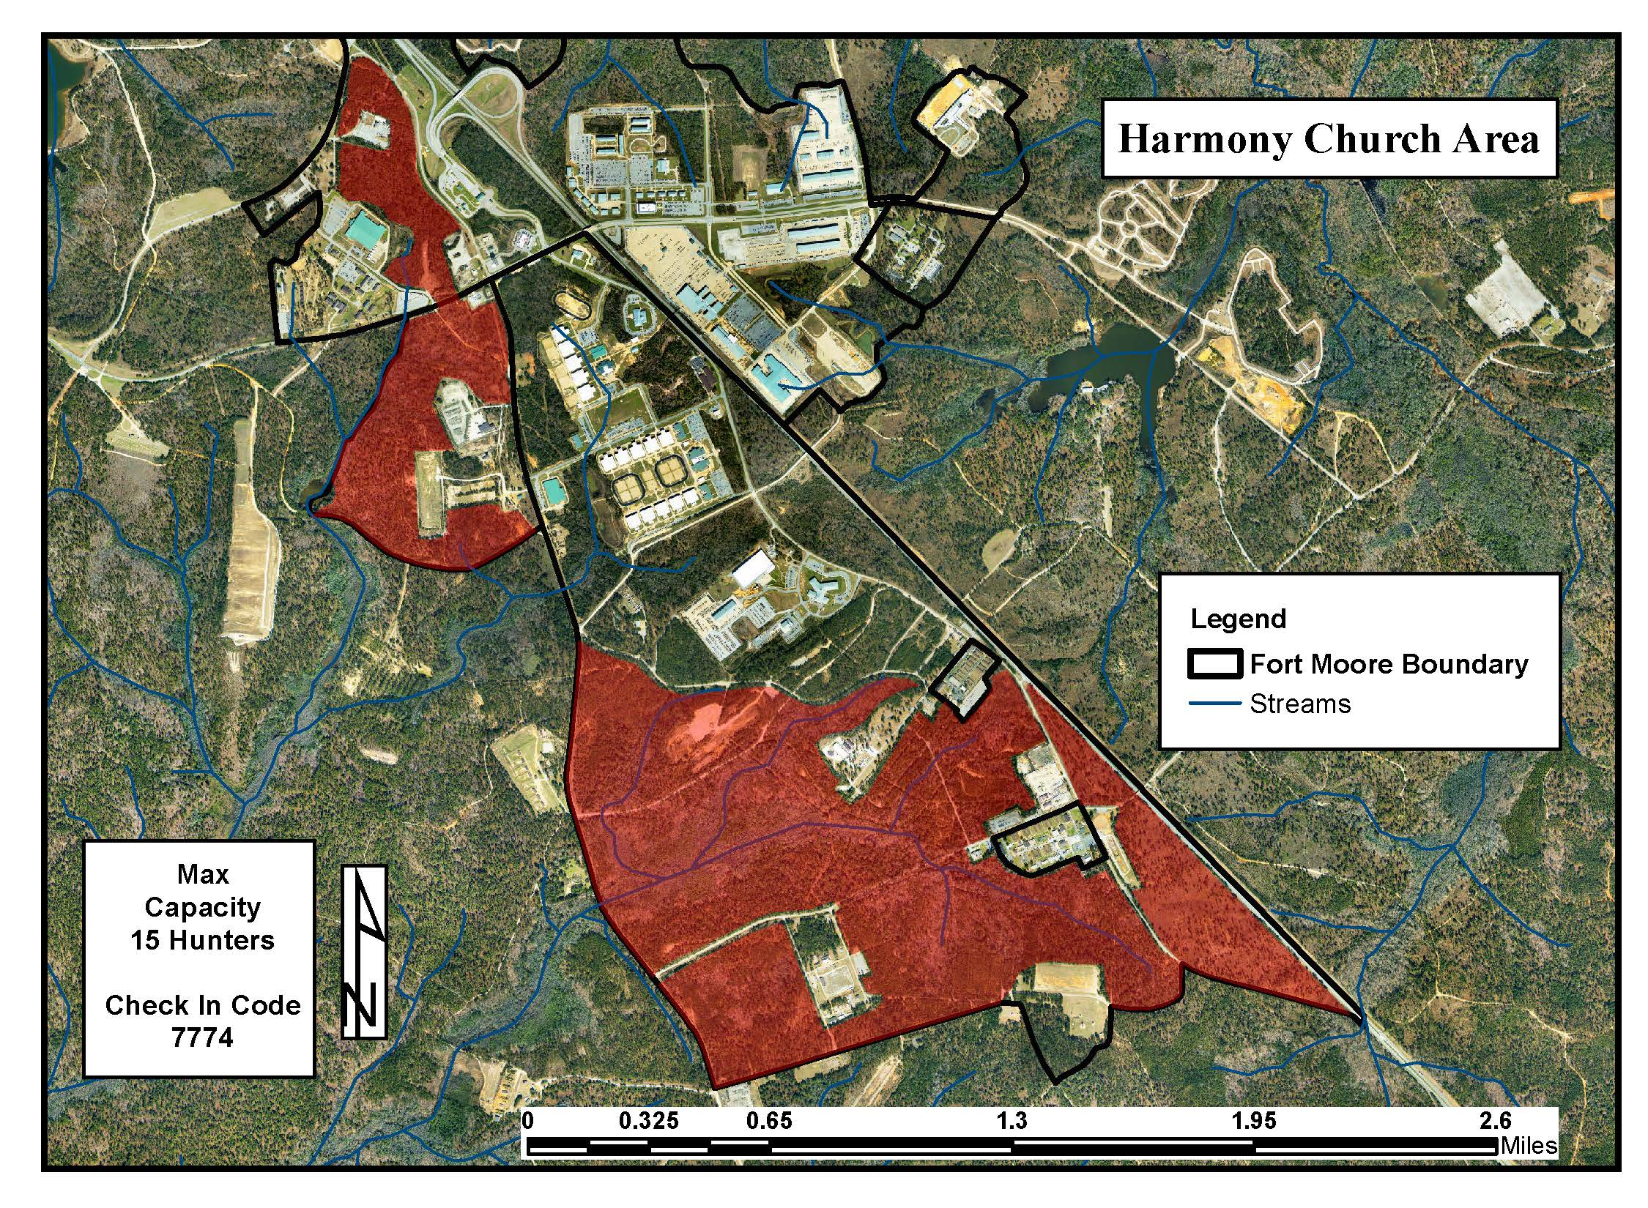
7774
15 Hunters

Slide 14
APHIS – Feral Swine Trapping
Trapping in and around Cantonment
  Check Facebook prior to hunting to ensure there are now restrictions in the area you wish to hunt. https://www.facebook.com/NRMBFortMoore/
  NRMB will post restricted areas and location of traps.
  NRMB will also post when areas are back open.
  Information will also be sent out via email distribution list.
  If you see a trap stay away from the trap, they have 24-hour monitoring systems.
  If you are hunting within site or 200 yards of a trap you will be hunting over bait.
  If hunters become a hindrance to the APHIS trapping effort, we will be forced to close the entire area containing the trap.

Slide 15
POC
Jeff Hutcherson
520-674-0449
Jeffery.w.hutcherson.civ@army.mil

