Slide 1
Review All Slides
Once Completed, send an email to jeffery.w.hutcherson.civ@army.mil
Stating you have reviewed all the Cantonment Archery Hunt (CAH) Briefing slides and fully understand the rules of participation.
If you have any questions on the material within, please call:
520-674-0449

Slide 2
CANTONMENT ARCHERY
2025-2026 Hunting Season
Rules of Participation
!!QDM POLICY DOES NOT APPLY!!

Slide 3
BLUF
This is a SPECIAL program; it is not part of the regular hunting program
DO
  !!!!!!!!! HARVEST DOES !!!!!!!!!
  BE CONSIDERATE OF OTHERS
  COMPLY WITH FB 200-1 REGULATION
  VACATE AREA IMMEDIATELY IF NON-HUNTERS OR TRAINING UNITS PRESENT
  ACT IN A PROFESSIONAL AND ETHICAL MANNER
DON’T
  JEAPORDIZE THE PROGRAM
  FIELD DRESS IN CANTONMENT AREAS
  BAIT IN ANY CANTONMENT AREAS

Slide 4
Requirements
Authorized individuals as stated in Ch 3-2 a. (1-12) of Regulation 200-1. NO GUEST HUNTERS
MUST have current Cantonment Area Archery Qualification Card/Access Pass (CAAQCAP), Post Hunting Permit, and GA Hunting License
MUST review briefing on iSportsman before qualification shoot
MUST send email to jeffery.w.hutcherson.civ@army.mil stating you have reviewed and understand the rules of participation.
MUST select a scheduled qualification shoot as announced (if required).
MUST bring and use own safety harness, bow and arrows w/ broadheads (practice mechanicals allowed) to qualification shoot. NO FIELD POINTS!
MUST qualify with bow by placing 2 of 3 arrows in 8” target at 30 yards from an elevated stand. Archers with traditional equipment can qualify at 20 yards.
MUST qualify with the weapon you will hunt with (bow and/or crossbow)
ONLY one attempt to qualify at each qualification session. !!! MAX of TWO ATTEMPTS PER HUNTER !!!

Slide 5
Qualification Proficiency Shoot
Participants who qualified prior to the previous season are not required to attend a qualification shoot this year; however, you are still required to send an email stating you have reviewed and understand the rules of participation.
New participants or participants who did not qualify in the previous season must qualify at a qualification shoot prior to the upcoming season.
Participants will need to request to qualify by emailing jeffery.w.hutcherson.civ@army.mil. Once requested, a qualification schedule will be sent to you via return email. An additional email confirmation will be required to hold your spot on the day you have selected.

Slide 6
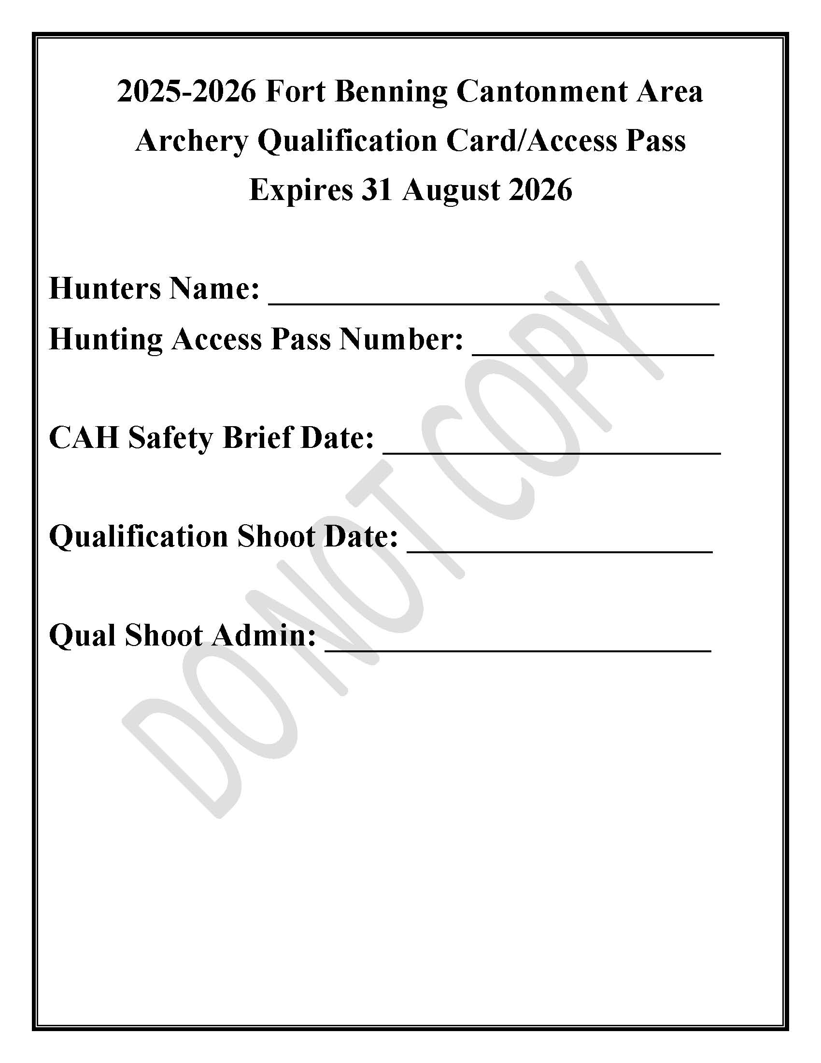
CAAQCAP will be emailed once qualified

Slide 7
SPECIFICS
CHECK IN
  iSPORTSMAN CHECK IN CODE 7771-7774 (See attached Maps)
  REPORT *ALL HARVESTED GAME*
TREE STANDS
  NO HUNTING FROM THE GROUND
  AT LEAST 10’ OFF THE GROUND
  NO SCREW IN PEGS, NAILS, ETC.
SCOUTING
  1100-1400 HOURS DURING DEER SEASON
  MUST CHECK IN THROUGH iSPORTSMAN

Slide 8
SPECIFICS (CONTD…)
PARKING
  DO NOT IMPEDE TRAFFIC FLOW
  DISPLAY CAAQCAP AND ACCESS PASS IN FRONT WINDSHIELD
ADDITIONAL INFORMATION
  NO STANDS WITHIN 200’ OF:
    HOUSES, ROADS, WALKING TRAILS, SCHOOLS, SCHOOL GROUNDS OR OTHER OCCUPIED INFRASTRUCTURE
  FOCUS ON HARVESTING DOES AND FERAL SWINE
HARVEST
  DEER – Post QDM DOES NOT apply, State and Post limits DO!
  WILD PIGS no limit
  COYOTES no limit

Slide 9
SPECIFICS (CONTD…)
REMOVING GAME
  DO NOT FIELD DRESS ANIMALS
  DISCRETE REMOVAL
  IF OUT OF DESIGNATED AREAS, CONTACT MP DESK AT 706-545-5222 BEFORE PROCEEDING IN TRACKING WOUNDED GAME
FIREARMS
  NO FIREARMS OF ANY TYPE IN POSESSION, INCLUDING IN VEHICLE
VIOLATIONS
  1 YEAR SUSPENSION
  3 YEAR RESTRICTION FROM CANTONMENT ARCHERY AREAS

Slide 10
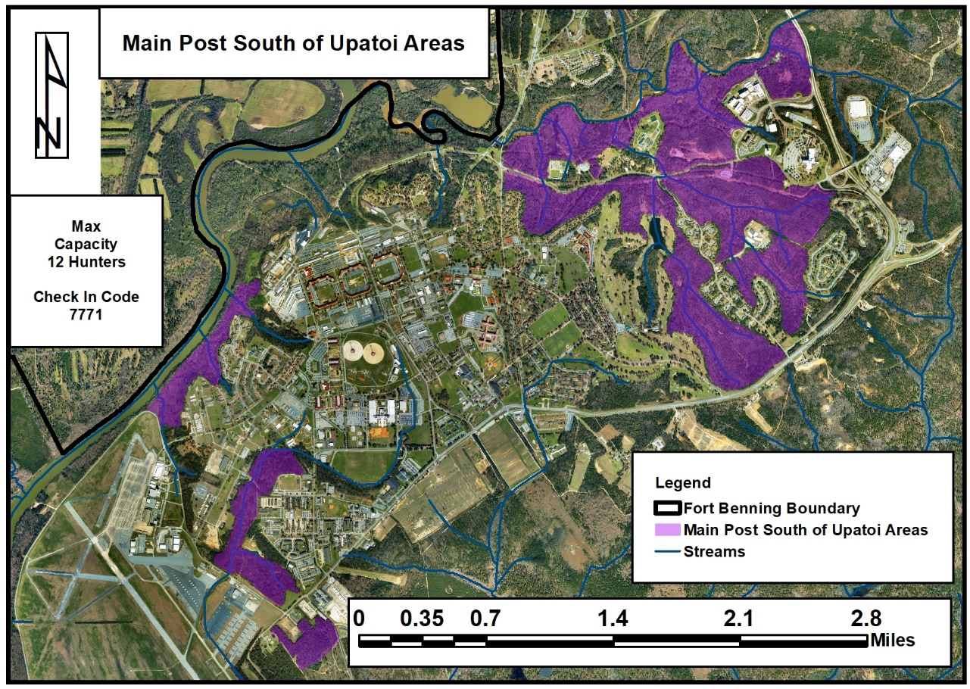

Slide 11
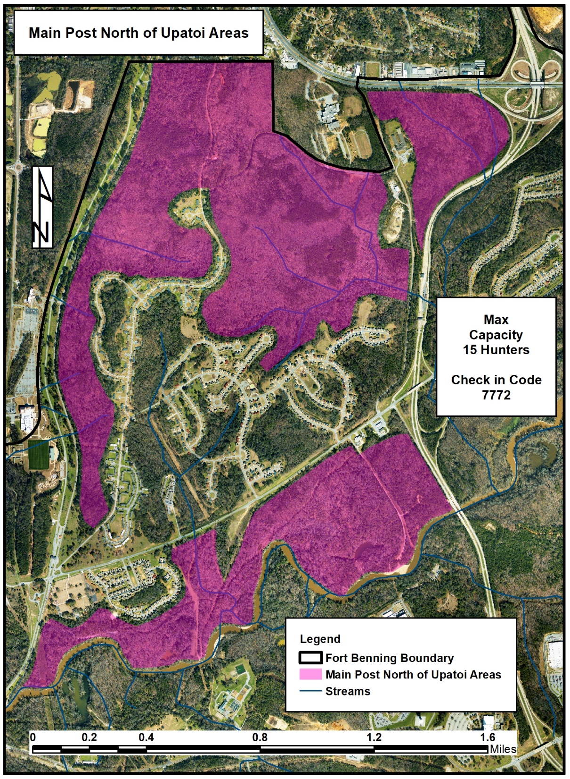

Slide 12
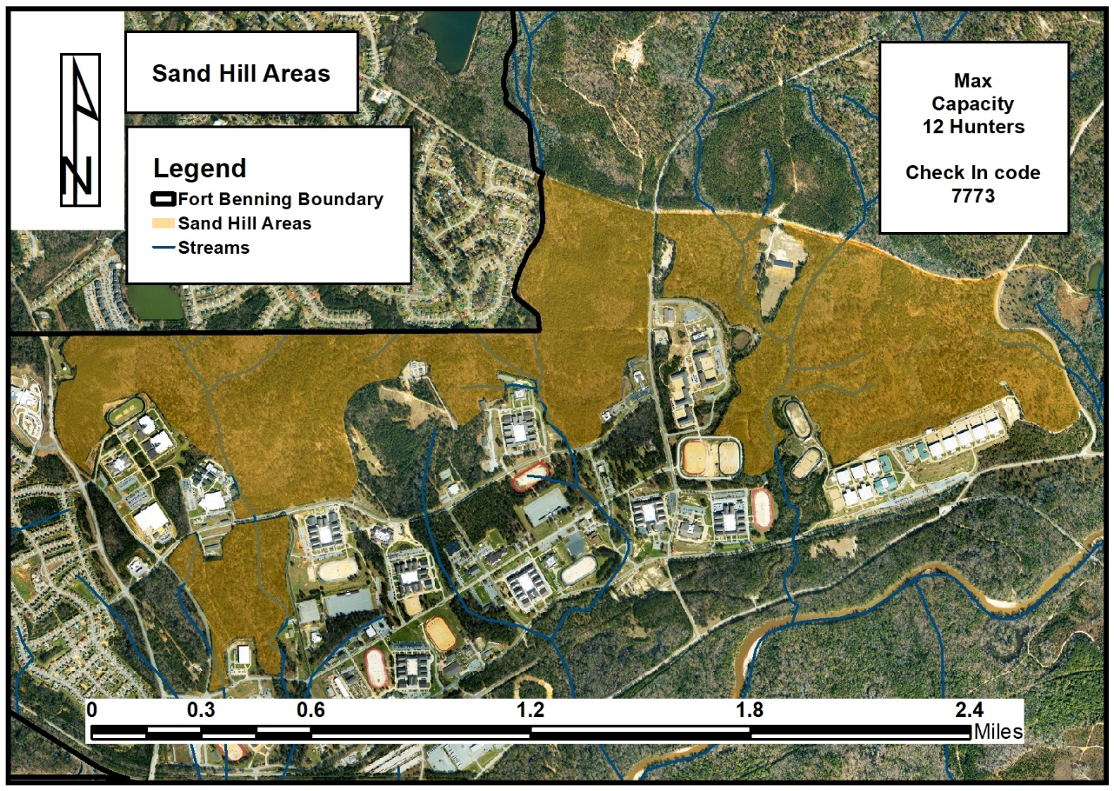

Slide 13
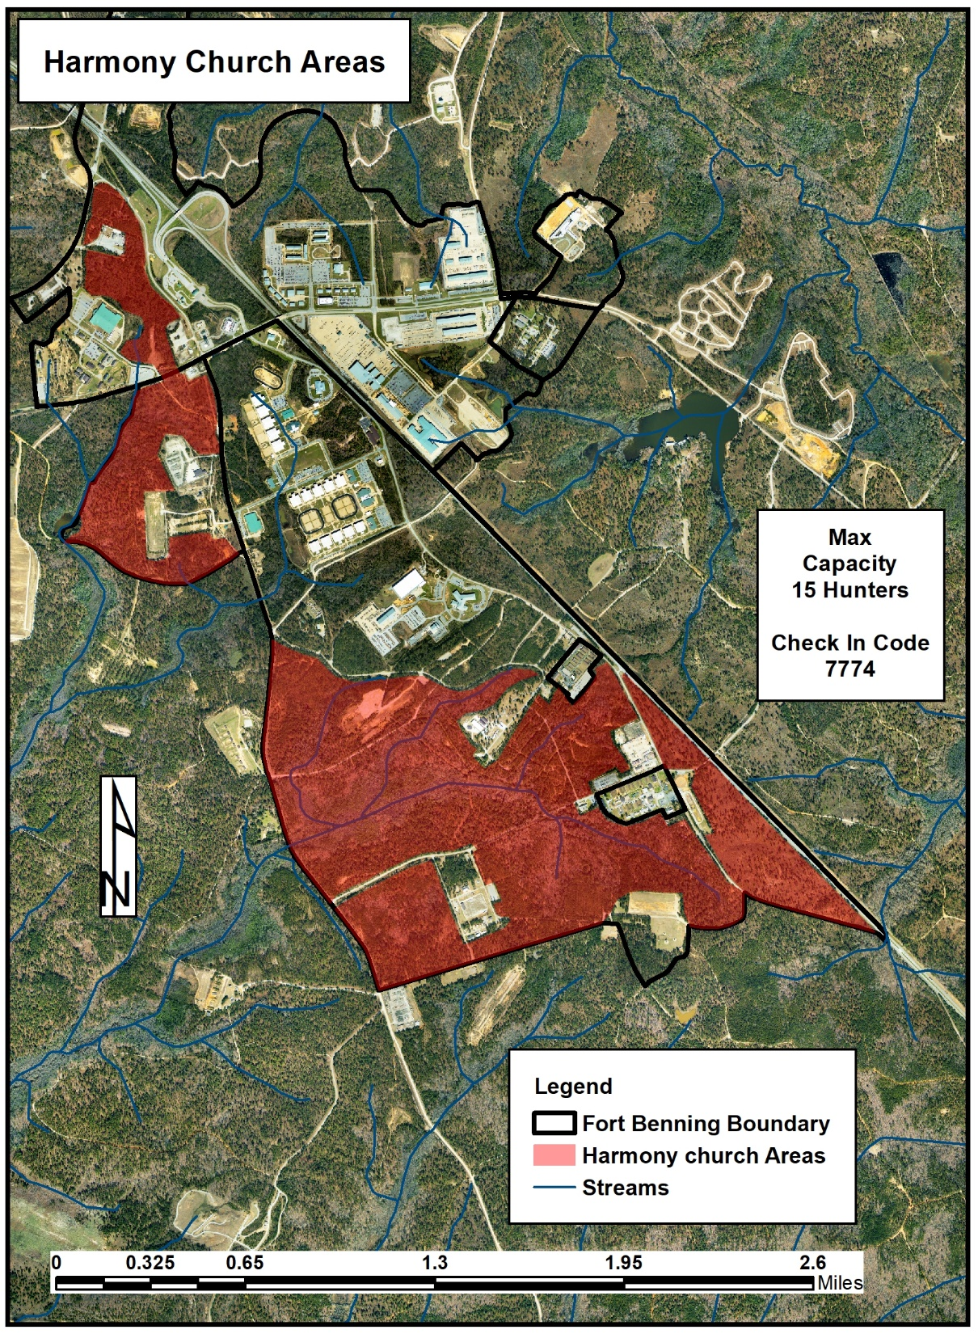

Slide 14
APHIS – Feral Swine Trapping
Trapping in and around Cantonment
  Check Facebook (https://www.facebook.com/NRMBFortMoore/) prior to hunting to ensure there are no restrictions in the area you wish to hunt.
  NRMB will post restricted areas and location of traps.
  NRMB will also post when areas are back open.
  Information will also be sent out via email distribution list and/or through iSportsman acknowledgement.
  If you see a trap stay away from the trap, they have 24-hour monitoring systems.
  If you are hunting within site or 200 yards of a trap you will be hunting over bait.
  If hunters become a hindrance to the APHIS trapping effort, we will be forced to close the entire area containing the trap.

Slide 15
POC
Jeff Hutcherson
520-674-0449
jeffery.w.hutcherson.civ@army.mil

